Slide 1
Multiple Choice Question MCQ
Dr. Majed Wadi
MBChB, MSc Med Edu

Slide 2
Objectives
To know basic concepts and rationale of MCQ
To know different types of MCQ
To illustrate anatomy of each type
To discuss guidelines construction of MCQ
To construct good SBA and EMQ

Slide 3
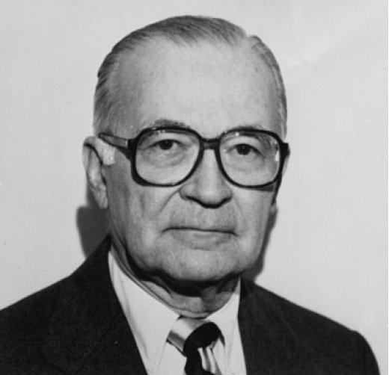
Background
Does
Shows how
Knows
Knows how
Observational instrument
OSCE
1919 - 1998
Written formats
MCQ, MTF, EMQ
Essays
Miller pyramid (19900

Slide 4
Written assessment
Constructed-response formats
Essays questions
Selected-response formats
MCQ

Slide 5
MCQ
It was invented in 1914 by Frederick Kelly
It is the most widely used format in medical and health professional education
It tests a wide proportion of knowledge

Slide 6
Strengths of MCQ
Broad representative content
Effective: contributes to high validity and reliability per hour of testing time
Objective: contributes to reliability
Defensibility
Accurate, timely feedback
Secure reuse of banked items
Cost-effective: administration and scoring
Higher-order thinking skills measureable if properly formatted

Slide 7
Weakness of MCQ
Resource-intensive: requires skill and time to write, especially context-rich questions
Often used to test recall of facts; trivialization
Promotes surface learning in students if used to test primarily recall
Promotes trivialization and avoidance of important areas and cognitive skills among item-writers if faced with difficulty in writing
Not able to assess summarizing and writing skills, critical thinking processes
Bad public relations
Guessing
Memorable

Slide 8
Types of MCQ
Multiple True False (MTF)
(X-type MCQ)
Single Best Answer (SBA)
(A-type MCQ)
Extended Matching Question (EMQ)
(R-type MCQ)

Slide 9
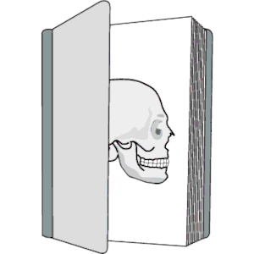
Anatomy of MCQ

Slide 10
General terms in MCQ Anatomy
Stem (item)
The main idea or content you want to test
Lead in question
To direct examinee toward selection
It is usually combined to stem
Options (alternatives)
Statements related to the stem
Key answer
The correct option
Distractors
The wrong options

Slide 11
SBA (A-type MCQ) Anatomy
Stem (item)
The main idea or content you want to test
Lead in question
To direct examinee toward selection
Options (alternatives)
Statements related to the stem

Slide 12
Example
A man of 68 presents with a sudden episode of severe colicky abdominal pain. Within three days of admission to hospital he becomes jaundiced and develops a high fluctuating pyrexia.
What is the most likely diagnosis in this patient?
Infective hepatitis
Cirrhosis of the liver
A stone impacted in the common bile duct
Carcinoma of the head of pancreas
An intrahepaticabscess
Stem
Lead-in Question
Options

Slide 13
MTF (X-type MCQ) Anatomy
Direction (description or notification)
Stem
Lead-in question (accordingly)
Options

Slide 14
Example of MTF
Direction
Answer by True or False
Which of the following is/are X-linked recessive conditions?
Hemophilia A (classic hemophilia)
Cystic fibrosis
Duchenne’s muscular dystrophy
Tay-Sachs disease
Stem and Lead-in question
Options

Slide 15
EMQ (R-type EMQ) Anatomy
It is like SBA in upside down structure
Theme
Options
Lead-in question
Stems (items)

Slide 16
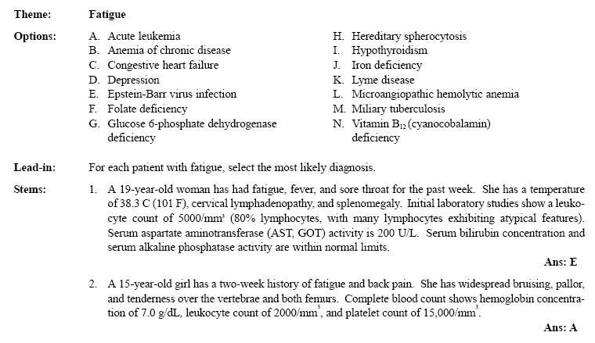
Example of EMQ

Slide 17
New trends in MCQ
MTF is abandoned by NBME (not recommended for use)
MTF was discouraged by most authorities
SBA and EMQ are widely used
They must design to in a good way to test higher level of thinking and application of knowledge

Slide 18
Guidelines to design good MCQ
Content
Format
Style
Stem
Options
(Haladyna, Downing, & Rodriquez, 2002 )

Slide 19
Guidelines to design good MCQ
Content
Format
Style
Stem
Options

Slide 20
Content guidelines
It must reflect specific content and focus on key concepts and principles that are essential for candidates
Base each item on important content, test material relevant for future career; avoid trivial content.
Use novel material to test higher level learning.
Keep the content of each item independent.
Avoid opinion-based items.
Avoid trick items.
Keep vocabulary simple and appropriate for the examinees tested.

Slide 21
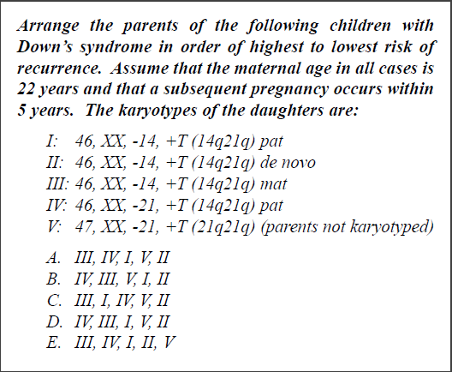
Example of tricky item

Slide 22
Guidelines to design good MCQ
Content
Format
Style
Stem
Options

Slide 23
Format guidelines
Use the question, completion, and best answer versions of conventional MC, the alternate choice, true-false, multiple true-false, matching, and the context-dependent item and item set formats, but avoid the complex MC format.
Format the item vertically, not horizontally.

Slide 24
Guidelines to design good MCQ
Content
Format
Style
Stem
Options

Slide 25
Style guidelines
Edit and proof items.
Use correct grammar, punctuation, capitalization, and spelling.
Minimize the amount of reading in each item.

Slide 26
Appropriate shaped item

Slide 27
Poorly shaped item

Slide 28
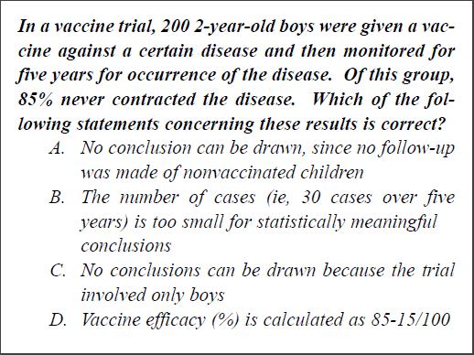

Slide 29
Guidelines to design good MCQ
Content
Format
Style
Stem
Options

Slide 30
Stem guidelines
Ensure that the directions in the stem are very clear.
Include the central idea in the stem, not in the options.
Avoid window dressing (excessive verbiage).
Word the stem positively, avoid negatives such as NOT or EXCEPT. If negative words are used, use the word cautiously and always ensure that the word appears capitalized and in bold type.

Slide 31
Guidelines to design good MCQ
Content
Format
Style
Stem
Options

Slide 32
Options guidelines
Develop as many effective choices as you can, but research suggests three is adequate.
Make sure that only one of these choices is the right answer.
Vary the location of the right answer according to the number of choices.
Balance the answer key, insofar as possible, so that the correct answer appears an equal number of times in each answer position.
Place the choices in logical or numerical order.
Keep choices independent; choices should not be overlapping in meaning.

Slide 33
Options guidelines cont’
Keep choices homogeneous in content and grammatical structure.
Keep the length of choices about equal.
None-of-the above should be used carefully.
Avoid All-of-the-above.
Phrase choices positively; avoid negatives such as NOT.

Slide 34
Options guidelines
Avoid giving clues to the right answer, such as:
Specific determiners including always, never, completely, and absolutely.
Clang associations, choices identical to or resembling words in the stem.
Grammatical inconsistencies that cue the test-taker to the correct choice.
Conspicuous correct choice.
Pairs or triplets of options that clue the test-taker to the correct choice.
Make all distractors plausible.

Slide 35
Absolute terms

Slide 36
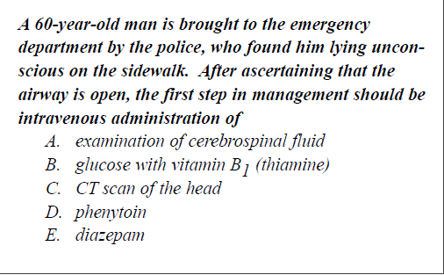
Grammar cues

Slide 37
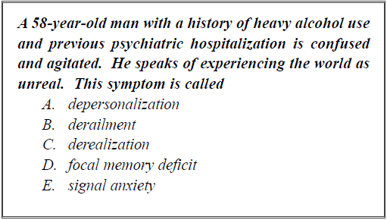
Word repeat

Slide 38
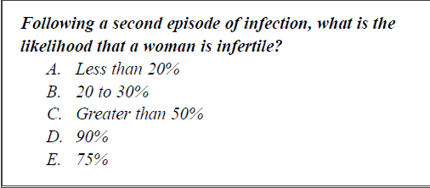
Inconsistency

Slide 39
Guidelines for EMQ
Identify the theme for the set.
Write the lead-in for the set.
Prepare the list of options.
Write the items.

Slide 40
Thank you

